Slide 1
Market Trends
Meta, Twitter, Snapchat

Slide 2
Social Media & The Stock Market
Facebook (Meta), Twitter, and Snapchat are 3 of the most popular social media platforms globally and in the United States.
In this presentation, we will examine how the share prices of these companies have changed over the past decade.

Slide 3
Goal
We want to see if the 3 companies have followed the same general trends in the market over the past 5 years.
This is not meant to be a rigorous examination. Our main focus was to look at dramatic climbs and falls, and see if any company behaved noticeably different than the others.

Slide 4
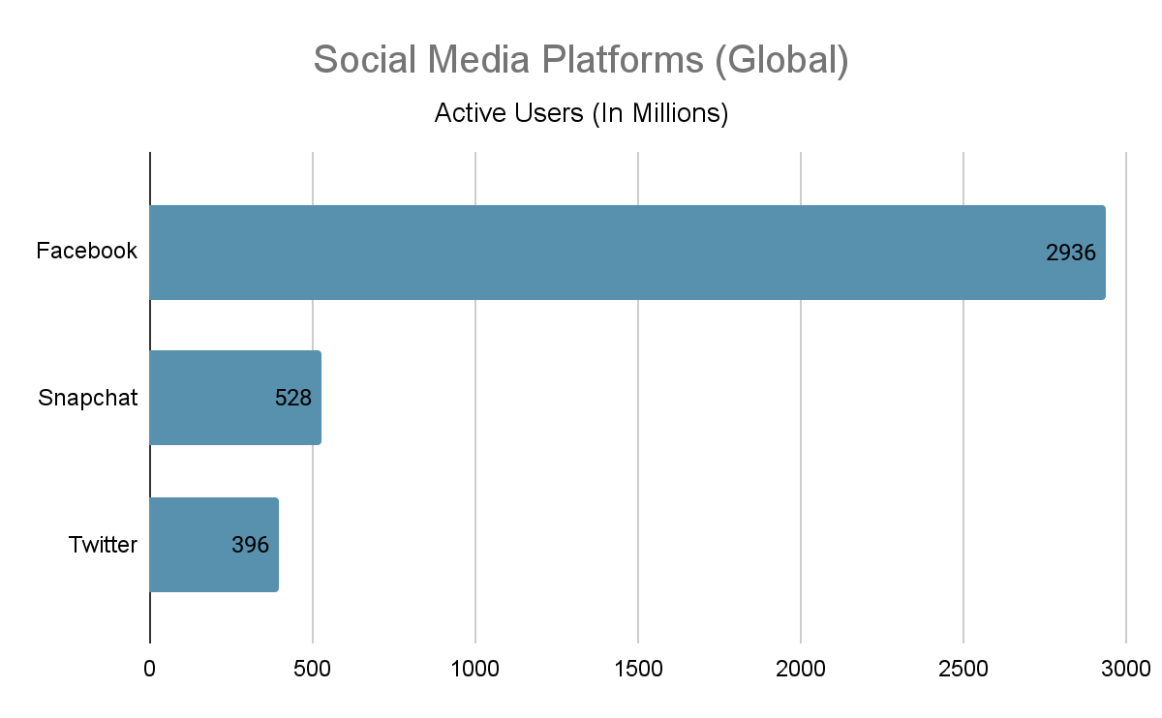
Social Media Giants
Meta (Facebook), Twitter, and Snapchat are 3 of the most popular social media platforms both in the U.S. and globally.

Slide 5
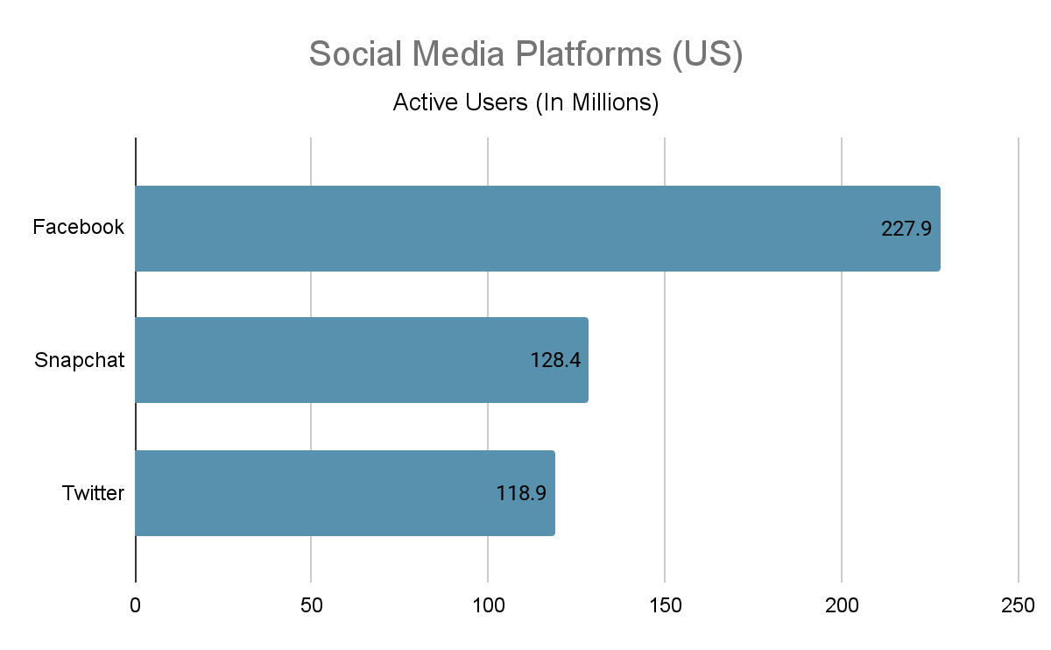

Slide 6
When did each enter the market?
Facebook (now Meta): May 18, 2012
Twitter: October 4, 2013
Snapchat: March 2, 2017

Slide 7
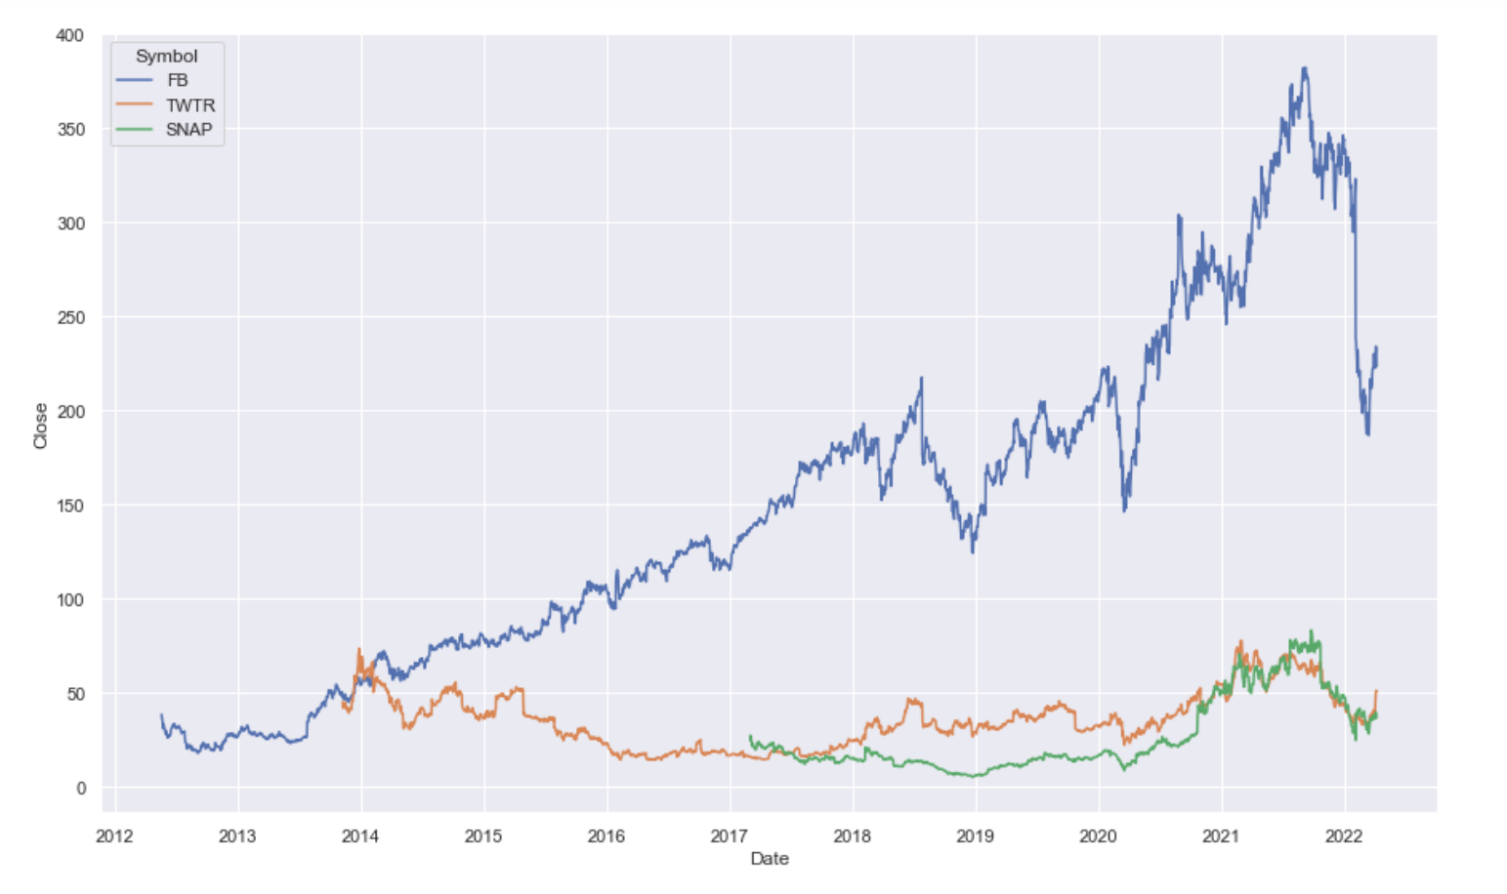
Closing Price (All Time)

Slide 8
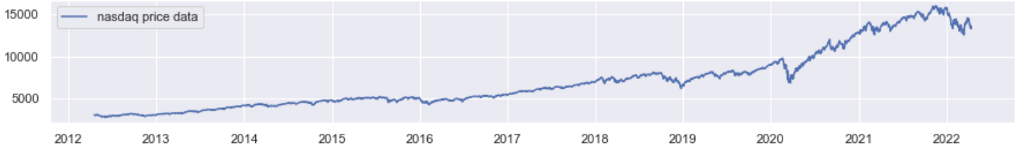
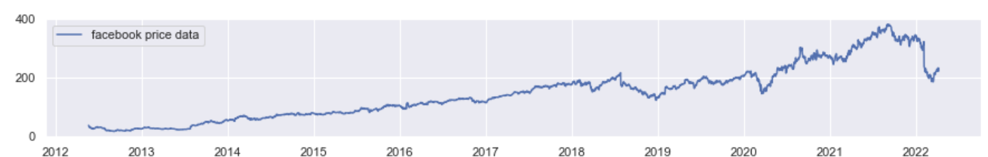
The Nasdaq Composite
This gives a heuristic of how the trends of FB/META compared to that of the overall stock market since 2012.
Notes:
The Nasdaq Composite is a stock market index that includes almost all stocks listed on the Nasdaq stock exchange. Along with the Dow Jones Industrial Average and S&P 500, it is one of the three most-followed stock market indices in the United States.

Slide 9
More recent market behavior
For a more recent comparison, we will now restrict our attention to the past 5 years (April 6th 2017 - April 6th 2022)

Slide 10
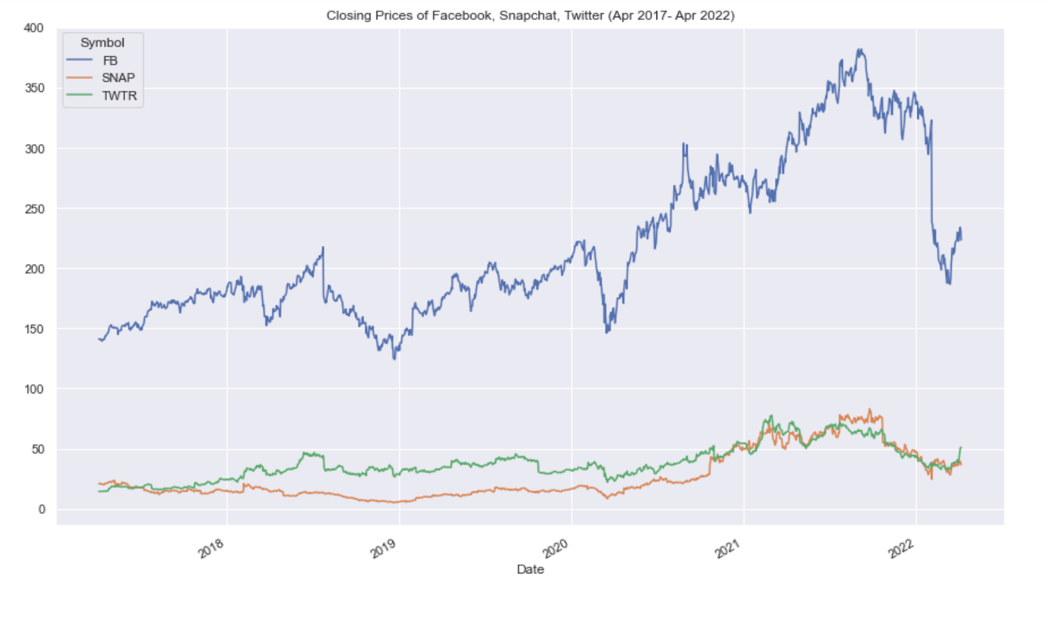
Closing Price (Past 5 Years)

Slide 11
Price Ratios
Looking solely at the share prices doesn’t tell the whole story.
To gain more insight on how the companies compared to each other, we will look at the relative value of each pair.
This was calculated by dividing the closing price of one by the closing price of another.

Slide 12
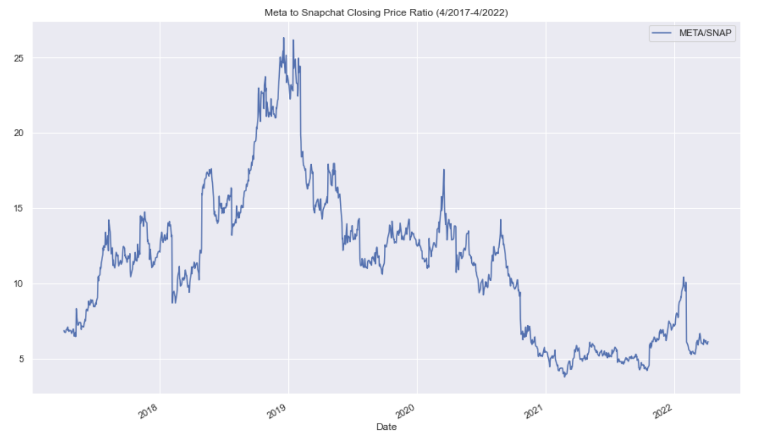
Relative Value: META vs SNAP

Slide 13
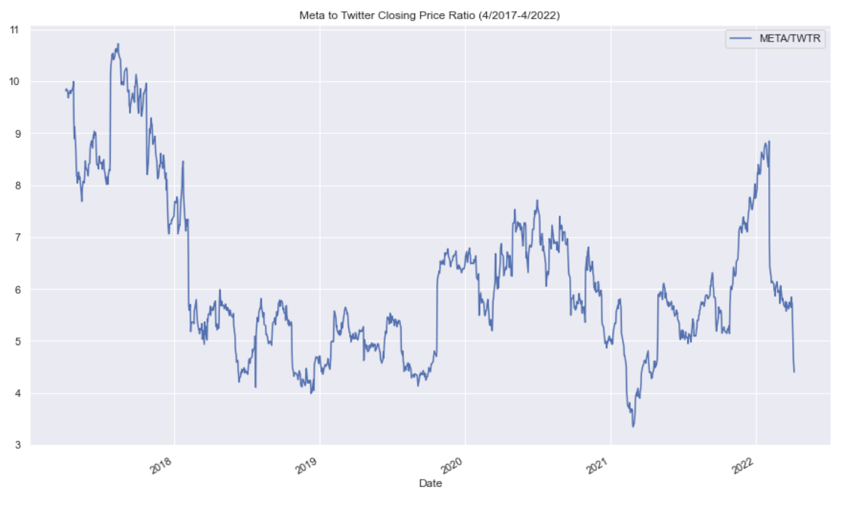
Relative Value: META vs TWTR

Slide 14
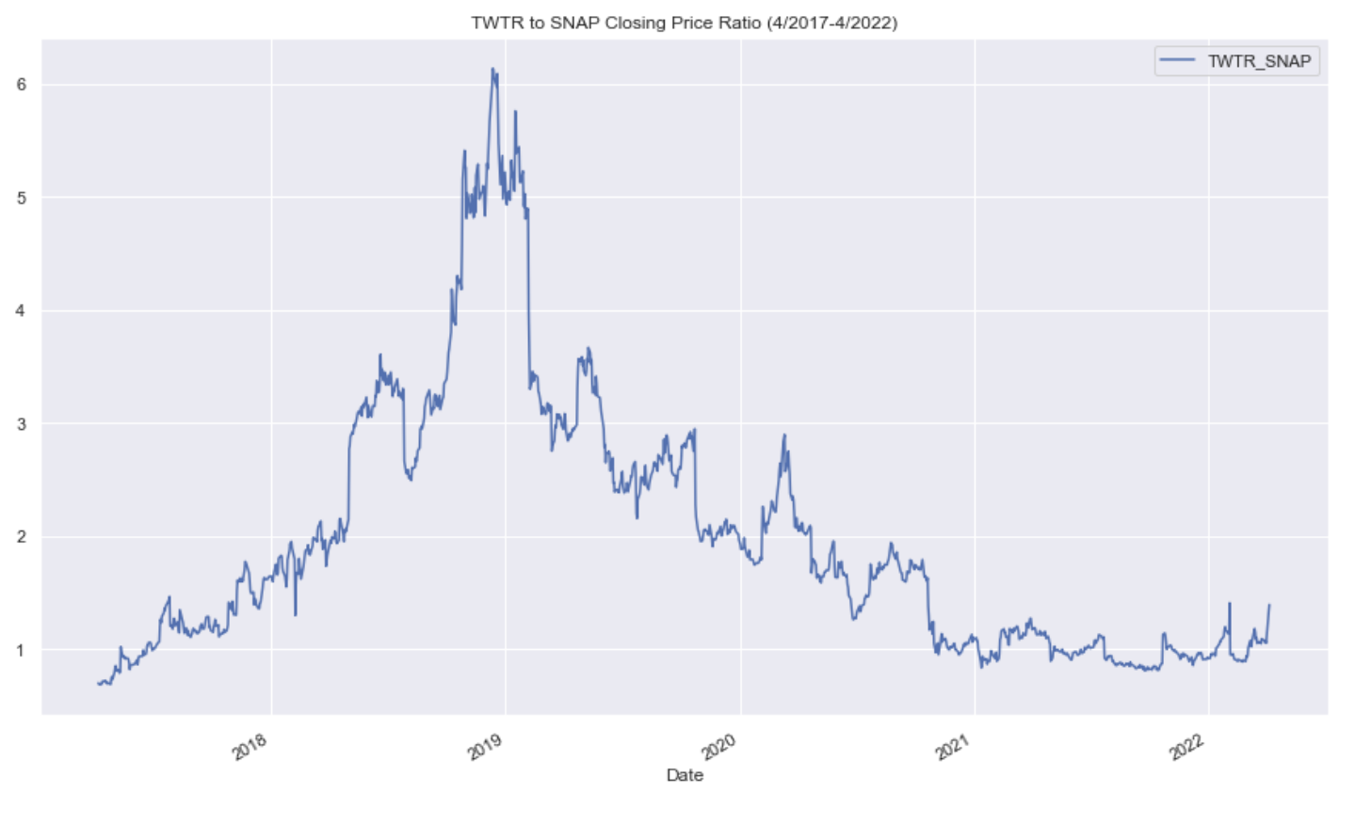
Relative Value: TWTR vs SNAP

Slide 15
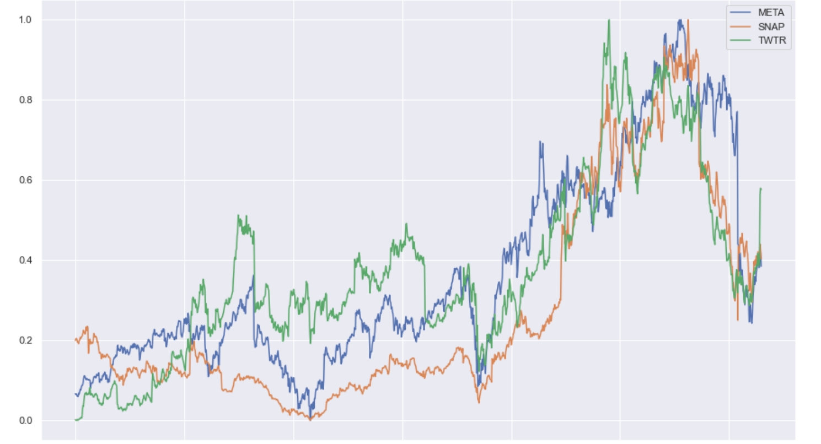
Scaled Closing Price Comparison
Here we can see how each company’s value changed relative to its own ATH (all time high) over the past 5 years.
Notes:
Minmax scaled past 5 years

Slide 16
Trend Summary
All 3 social media companies tend to follow similar patterns in recent years, with significant growth between early 2020 and late 2021.
This was followed by a sharp decline in early 2022.
Between mid 2018 and late 2020, Snapchats relative value to Meta and Twitter decreased dramatically, with a peak discrepancy occurring between late 2018 and early 2019.

Slide 17
References
https://www.theglobalstatistics.com/united-states-social-media-statistics/
https://en.wikipedia.org/wiki/Social_networking_service

